Slide 1

课时练习
模块六 第三章 第二节

Slide 2
一、翻译下列词组。
1. 戴自行车头盔 _____________________
2. 违反交通规则 _____________________
3. 被处以罚金，收到罚单 _____________
4. 处于危险中 _______________________
5. 在左手边 _________________________
wear bicycle helmets
break the traffic rules
get a fine
be in danger
on the left-hand side

Slide 3
二、根据语境、音标或所给单词的提示完成句子， 每空一词。
1. Drivers may cause trouble if they park in the ________ place.
2. The man got a heavy fine for ________ (drive) too fast.
3. We shouldn’t be _________ (care) about our spelling(拼写).
wrong
driving
careless

Slide 4
二、根据语境、音标或所给单词的提示完成句子， 每空一词。
4. A _______ /ˈhelmɪt/ can protect people from serious head injury(损伤) in the accident.
5. Squirrels(松鼠) are ______ /ˈbɪzi/ gathering food in autumn for the long winter ahead.
helmet
busy

Slide 5
三、单项选择。
( )1. Lucy is ______ and she seldom makes mistakes(错误).
A. useful B. hopeful C. careful
C

Slide 6
三、单项选择。
( )2. Students must return the books to the library on time, or they have to pay a _____.
A. surprise B. fine C. ticket
B

Slide 7
三、单项选择。
( )3. —Why not go to see flamingoes(火烈鸟) in the zoo this afternoon?
—______. We’re sure to have great fun.
A. Good idea
B. That’s right
C. Thank you
A

Slide 8
三、单项选择。
( )4. We _____ each other on the travel plan, so we didn’t decide on where to go.
A. disagreed with
B. learned about
C. worried about
A

Slide 9
三、单项选择。
( )5. If Tim _____ early, he will be able to catch the earliest train to Beijing.
A. will start B. starts C. start
B

Slide 10
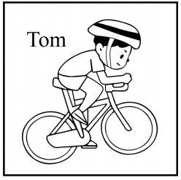
四、看图写话。
1. always, wear, when
Tom always wears a helmet when riding (a bike).

Slide 11
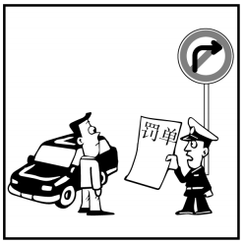
四、看图写话。
2. fine, for
The man/He got a fine for making a wrong turn.

Slide 12
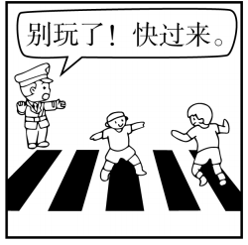
四、看图写话。
3. tell, play
The policeman tells/told the children not to play on the road.

Slide 13
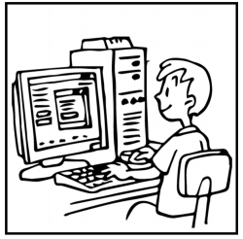
四、看图写话。
4. carefully, now
The boy/He is working on the computer carefully now.

Slide 14
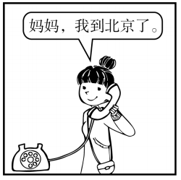
四、看图写话。
5. as soon as, arrive
The girl called her mother as soon as she arrived in Beijing.

Slide 15


